Slide 1
Environmental concerns
Tiange Wang & Haotian Xue - The Australian National University

Slide 2


Reference
References:
http://www.arborenvironmentalalliance.com/carbon-tree-facts.asp
http://www.tomw.net.au/How_Green_is_My_Computer/#ch33678
http://www.tomw.net.au/ict_sustainability/enabling.shtml

Slide 3

Bring your thoughts
Estimate the Greenhouse Gas Emissions from Computers
For example a small desktop computer might consume 50 Watts of power and be used for 8 hours a day:
50 Watt x 8 Hours a day x 365.25 days a year / 1,000 Watt in Kilowatt = 146.1 kWhr per year
A Greenhouse gas conversion factor is then used to convert energy consumed in Kilowatt Hours (kWh) to kg of equivalent carbon dioxide. The conversion factor is about 1 Kg CO₂/kWh for electricity generated by burning coal.
One small desktop computer produces:
146.1 kWhr per year x .89 Kg CO₂/kWh = 130 Kg CO₂ per year.

Slide 4

Bring your thoughts
What about trees?
A single tree can absorb CO2 at a rate of 48 lb. per year, which is equal to 21.6 kg.

Slide 5
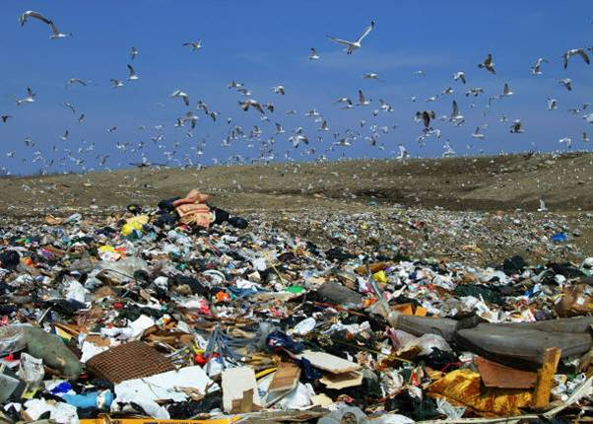

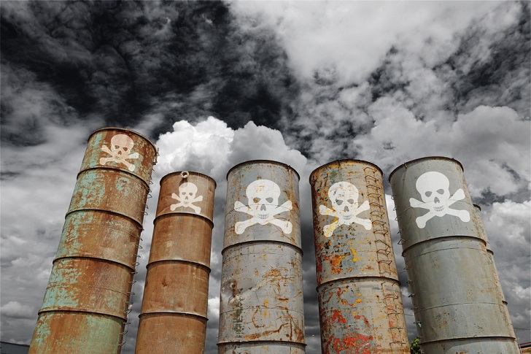

Slide 6

The first discussion
Think about the traditional solutions to these issues
10 mins

Slide 7
Improvement
What if we solve the problem using computers?
What can we do with our computers?
Just shutting them down to stop them from emitting more CO2?
Use your system thinking and your computing background.

Slide 8
Improvement
Hint:
What is the main reason that causes the greenhouse gas?
Can we decrease that?
How?
Key Words: Industry development, Vast use of vehicles, Forest area decreased, Overuse of air conditioner…….

Slide 9
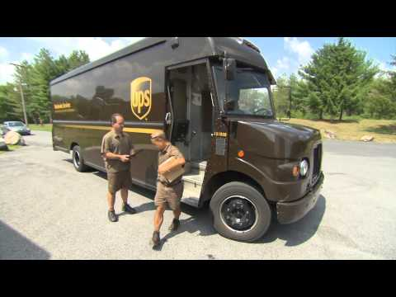
Improvement

Slide 10
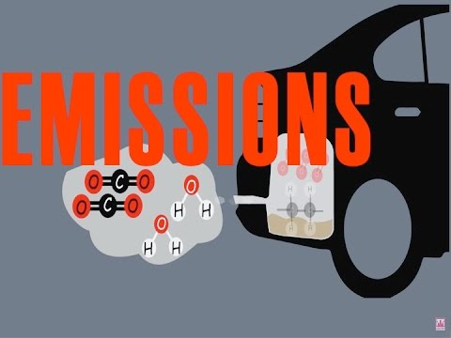
Our ideas

Slide 11
Improvement and its effect
Example: Dematerialisation substitutes low carbon alternatives for high carbon products and services.
Advantage:save resources (really?)
What about disadvantages?

Slide 12
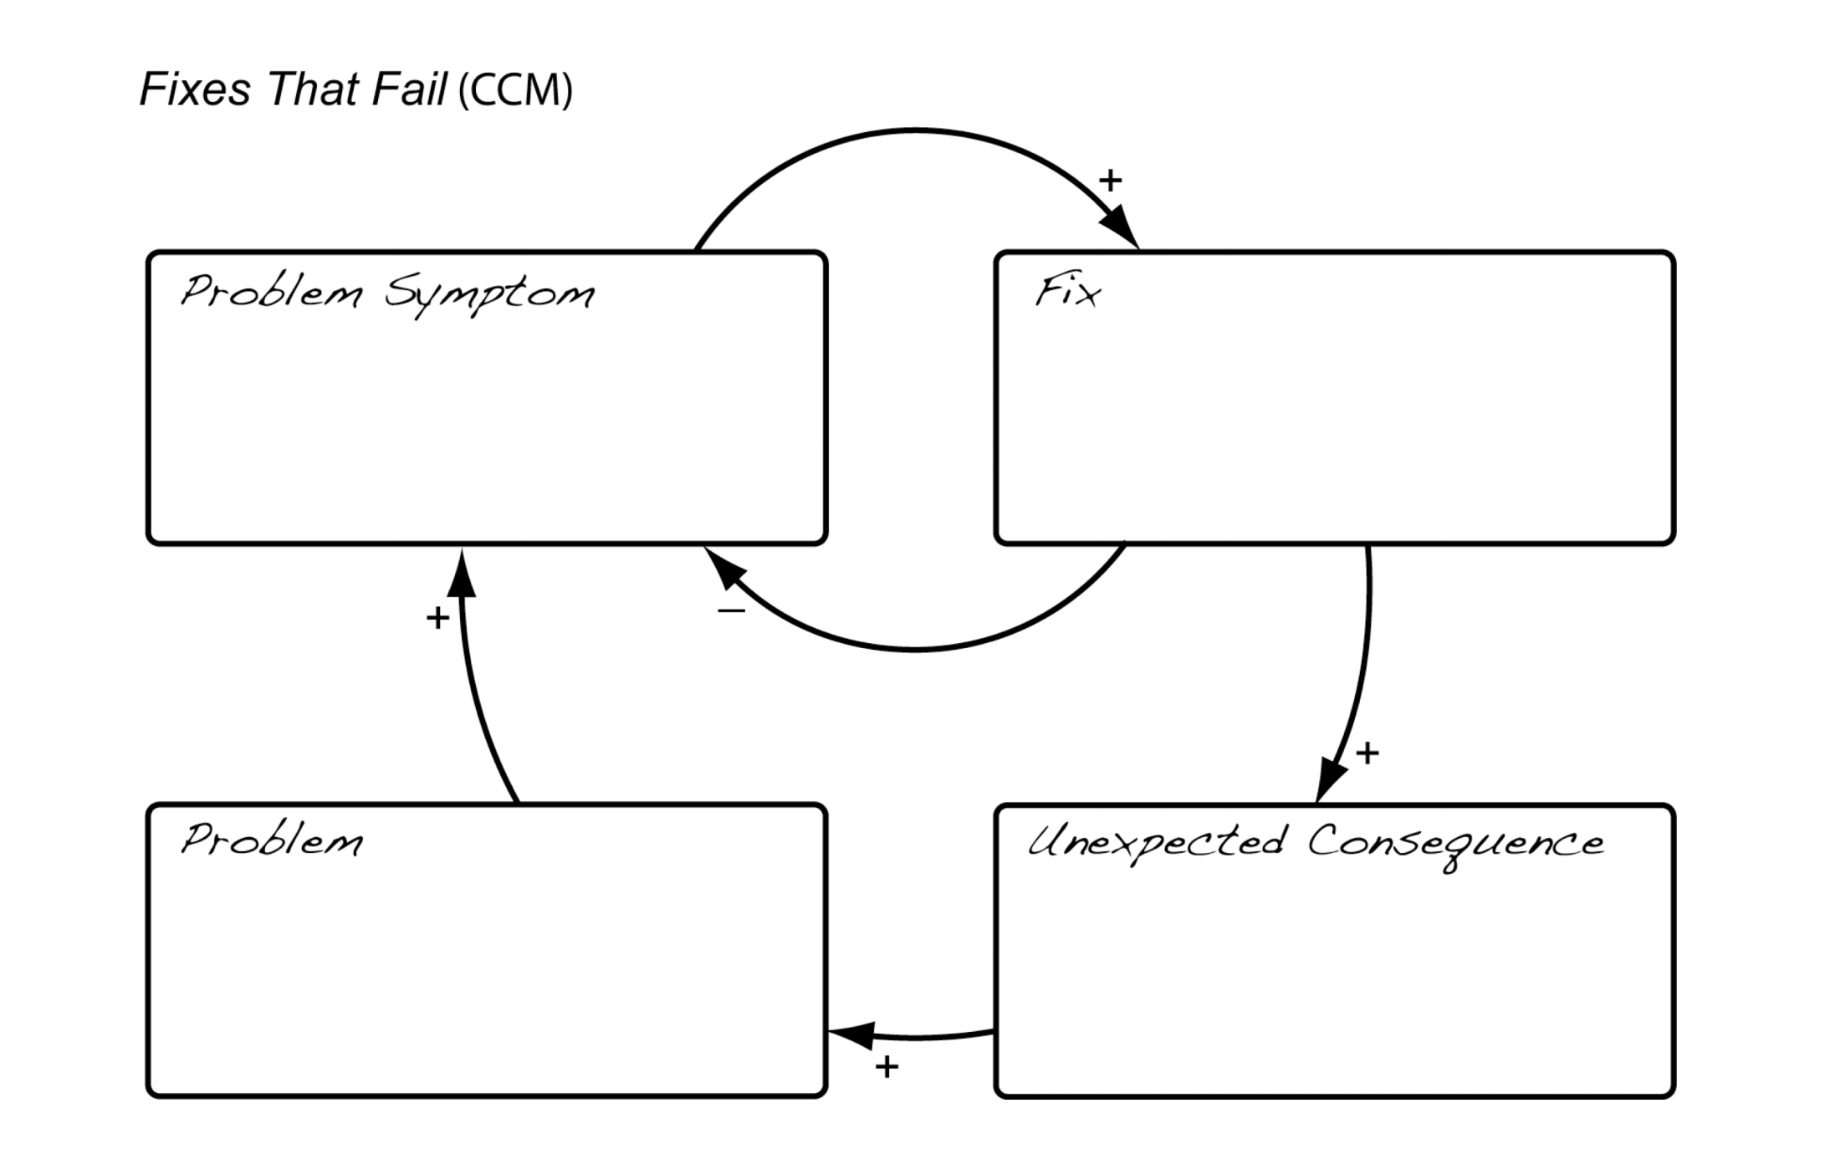
Improvement and its effect
Draw the Reinforcing Feedback loop you have already drawn in last week’s lecture to analyze it!
20 mins

Slide 13
Improvement and its effect
Recycle CO2 by means of technology
Reducing vehicles use
Using sustainable resources
Dematerialisation substitutes low carbon alternatives for high carbon products and services.(replacing traveling to meetings with teleworking via computer and videoconferencing.)
Add double the current global nuclear capacity to replace coal-based electricity.

Slide 14
Summary
What we have been through so far:
Introducing some environmental issues and their possible traditional & IT solutions
Using the critical thinking to focus on the disadvantages of the feasible solutions
Help you revisit and apply last two week’s content to solve problems (design thinking and system thinking)
Hope all of us have green IT minds!

